Slide 1
Front End Engineering-I Project
Team Details:
Team Details:
> Aryan Sharma (2410990108)
> Aditya Garg (2410990093)
> Pranav Sharma (2410991479)
Faculty Coordinator:
Mrs Ravneet Kaur
:
Chitkara University Institute of Engineering and Technology,
Chitkara University, Punjab

Slide 2
Introduction
References/
Links used
Problem
Statement
1
8
2
Table of Contents
7
3
Technical
Details
Conclusion
6
4
5
Bonus Feature
Key
Features
Project
Highlights

Slide 3
Introduction
Title of project:- StreetTee
Objective:-
StreetTee is a modern e-commerce platform offering a curated selection of streetwear fashion for individuals who value style and uniqueness. The site is designed to bring trendy, quality clothing directly to the customer, making fashionable choices easily accessible. It features a wide variety of stylish streetwear items, from tops to shoes, appealing to a youthful audience looking to express individuality through fashion. StreetTee aims to make shopping smooth and enjoyable, offering features like a user-friendly interface, responsive design, and a visually captivating layout. Our brand focuses on merging fashion and functionality, giving customers a seamless experience and helping them stay ahead of streetwear trends.

Slide 4
Problem Statement
Today’s fashion-savvy youth face difficulty finding unique, stylish clothing in one easy-to-navigate online space. Most e-commerce websites lack the focus and aesthetic appeal that resonates with urban, trend-oriented customers. Limited options, cluttered layouts, and a lack of personalization hinder the shopping experience. StreetTee seeks to solve this by offering a tailored platform that combines trendy streetwear with an intuitive user interface. By addressing these challenges, StreetTee aims to bridge the gap between demand for stylish clothing and the limitations of traditional e-commerce sites, creating a platform that is both stylish and easy to use

Slide 5
Technical Details
The StreetTee platform is built with a clean HTML and CSS structure, focusing on responsive design for optimal performance on all devices. We use HTML for structuring the navigation, main sections (such as shop, review, blog, and contact), and CSS for styling. Advanced CSS techniques ensure smooth transitions, animations, and user-friendly hover effects that make browsing dynamic and visually engaging. JavaScript adds interactivity, such as pop-ups and clickable product details, enhancing the shopping experience. The responsive design adapts seamlessly across screens, and custom fonts are applied via Google Fonts for a fresh, modern look that aligns with the streetwear aesthetic.

Slide 6
Key Features
StreetTee’s standout features include a clean, visually appealing hero section that highlights fashion promotions, a well-organized shop page showcasing trendy items with pricing and ratings, and a customer review section for feedback and testimonials. The blog section engages users with articles on fashion trends and styling tips, while the contact form facilitates direct communication. The site offers smooth transitions, intuitive navigation, and a responsive layout. Each section is designed to maximize engagement, encouraging users to explore and return for future purchases. The use of quality images and interactive buttons ensures that each user interaction feels personalized and straightforward.

Slide 7
Project Highlights
The screenshot in the next slide shows our StreetTee project.
The ones that follow contain the HTML and CSS code used to design it.

Slide 8
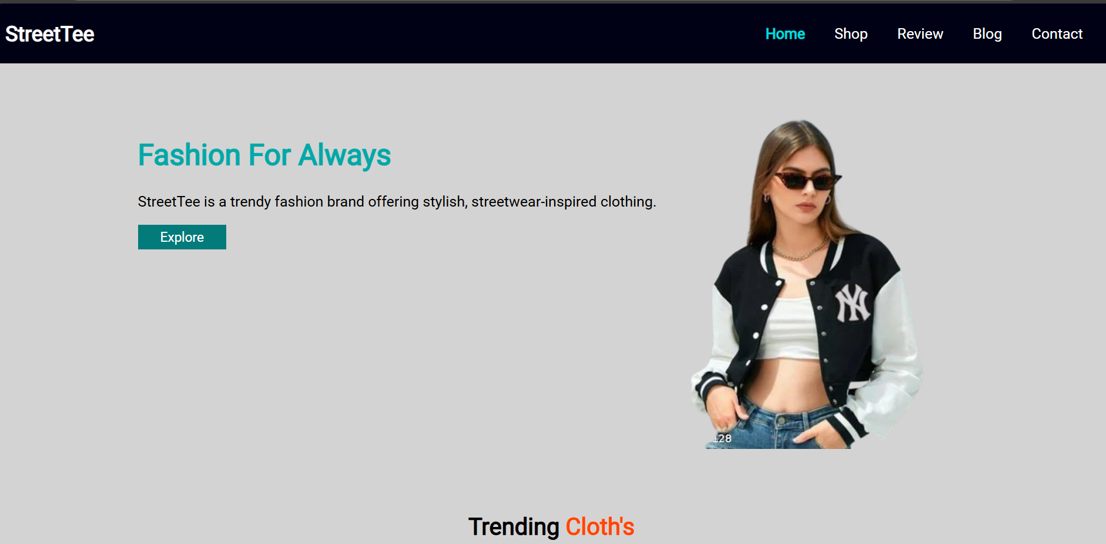

Slide 9
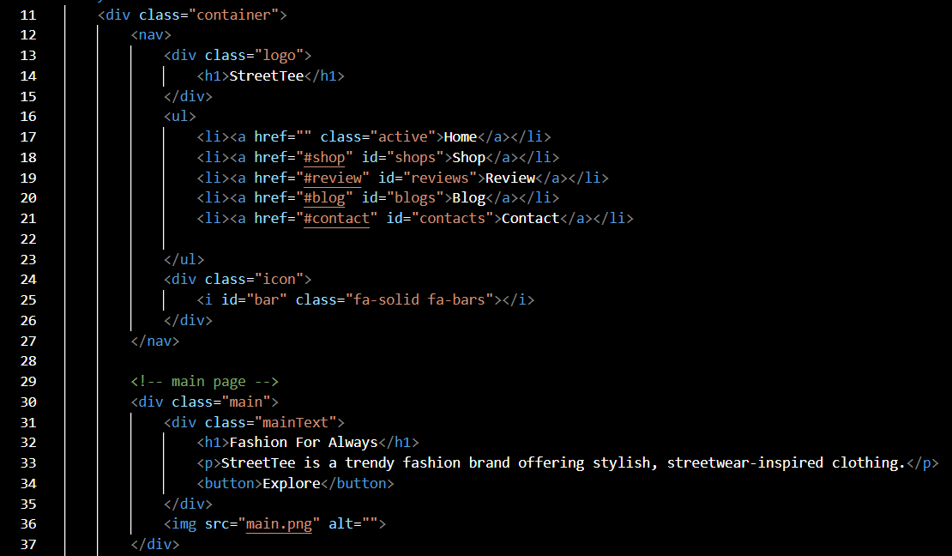

Slide 10
Bonus Feature(optional)
This slide should highlight any specific feature which is distinct and innovative in your project.

Slide 11
Conclusion
This slide should summarize the key points of the project and the team's main takeaways from the experience.

Slide 12
References/Links used
This slide should include a list of all the sources and references used in the project.

Slide 13


